Slide 1
Water Rates

Slide 2
Where Does Our Water Come From?
Historically we bought water from the Detroit Water System.
The Great Lakes Water Authority leased the assets of Detroit and now provides the service.
Washington Township is the go between GLWA and our Customers.
We also maintain local assets.

Slide 3
Water and Sewer
Key Infrastructure
Sewer System
Water System
384,185 feet of sanitary sewer main (72.8 Miles)
5 pump stations
One meter pit
Sewer plant (pending)
508,792 feet of water main (96.4 miles)
Water storage facility (1.5mm g)
2 booster stations
2 meter pits
7 pressure reducing valves (PRVs)
Meters / remote reading devices

Slide 4
Why Is My Bill So &^%$#! High?
Two major factors influenced bills for the quarter ending June 30, 2017:
  Detroit hit us with a 25% increase effective July 1, 2015. That extra cost was NOT in last year’s bill for the April to June period.
  We are in a drought this season. Sprinklers are on overdrive.

Slide 5
Rainfall Comparison
Note that this is the lowest rainfall for this quarter in 10 years

Slide 6
How Are Rates Determined?
GLWA has multi-year contracts with the towns in the DWSD service territory.
The contracts are essentially the same other than the estimates of pressures, peaks, and total estimated flows.
Rates are based on a consistent formula (GLWA/Detroit dictates – not negotiated):
  Ave distance from DWSD pumping facilities
  Elevation
  Our Peak Flows in Relation to Total System Peaks
There are no special deals

Slide 7
What Does the Formula Mean For Us?
We can’t change our elevation.
We can’t change our distance from Detroit facilities.
As a bedroom community with little industrial, we have few options on our peak usage until now.

Slide 8
Water Storage Facility
Peak hours of usage tend to be 6-9 am and 6-9 pm.
Our decision to build a 1.5mm gallon water storage facility for $4.5mm was so that we can manage away from those hours.
Facility is essentially complete.
Must operate for several months prior to reopening the contract.
New rates will take affect July 2017.

Slide 9
But Aren’t You Running at a Surplus?
We strive to run at a surplus each year. Some years, depending on whether, we do not. Running at a surplus does not mean we are overcharging.
We have 96 miles of water main and 73 miles of sewer main and other facilities that must be replaced over time at substantially higher cost than their original cost decades earlier.
We must run surpluses to set aside money to repair/replace those facilities.
Failure to do so would be irresponsible and mortgage the future of the public works utility.
Remember this is not someone else’s asset – it is YOURS. You do not want us irresponsibly mortgaging your future.

Slide 10
Why Fixed Charges?
In 2010 Detroit began charging BOTH fixed and variable.
Their rationale is that when people use less water (rainy years) they still have very large fixed costs. https://www.youtube.com/watch?v=N-vETlIzvCo
The percentage of the Detroit bill that is fixed moved from 13% to 60% since 2010.
The percent of your monthly bill that is fixed will bounce around throughout the year based on usage (snowbirds, rainy vs dry seasons, etc.).

Slide 11
Why Are Neighbors Cheaper?
We are one of the highest charged by DWSD.
We are far away, high, and strain their system in peak times – the three items the formula is based on.
Politics often influences water rates. Many of the towns shown as examples lose $1.5mm per year in operations. Is that responsible?
This is YOUR system. That would be YOU losing $1.5mm per year.

Slide 12
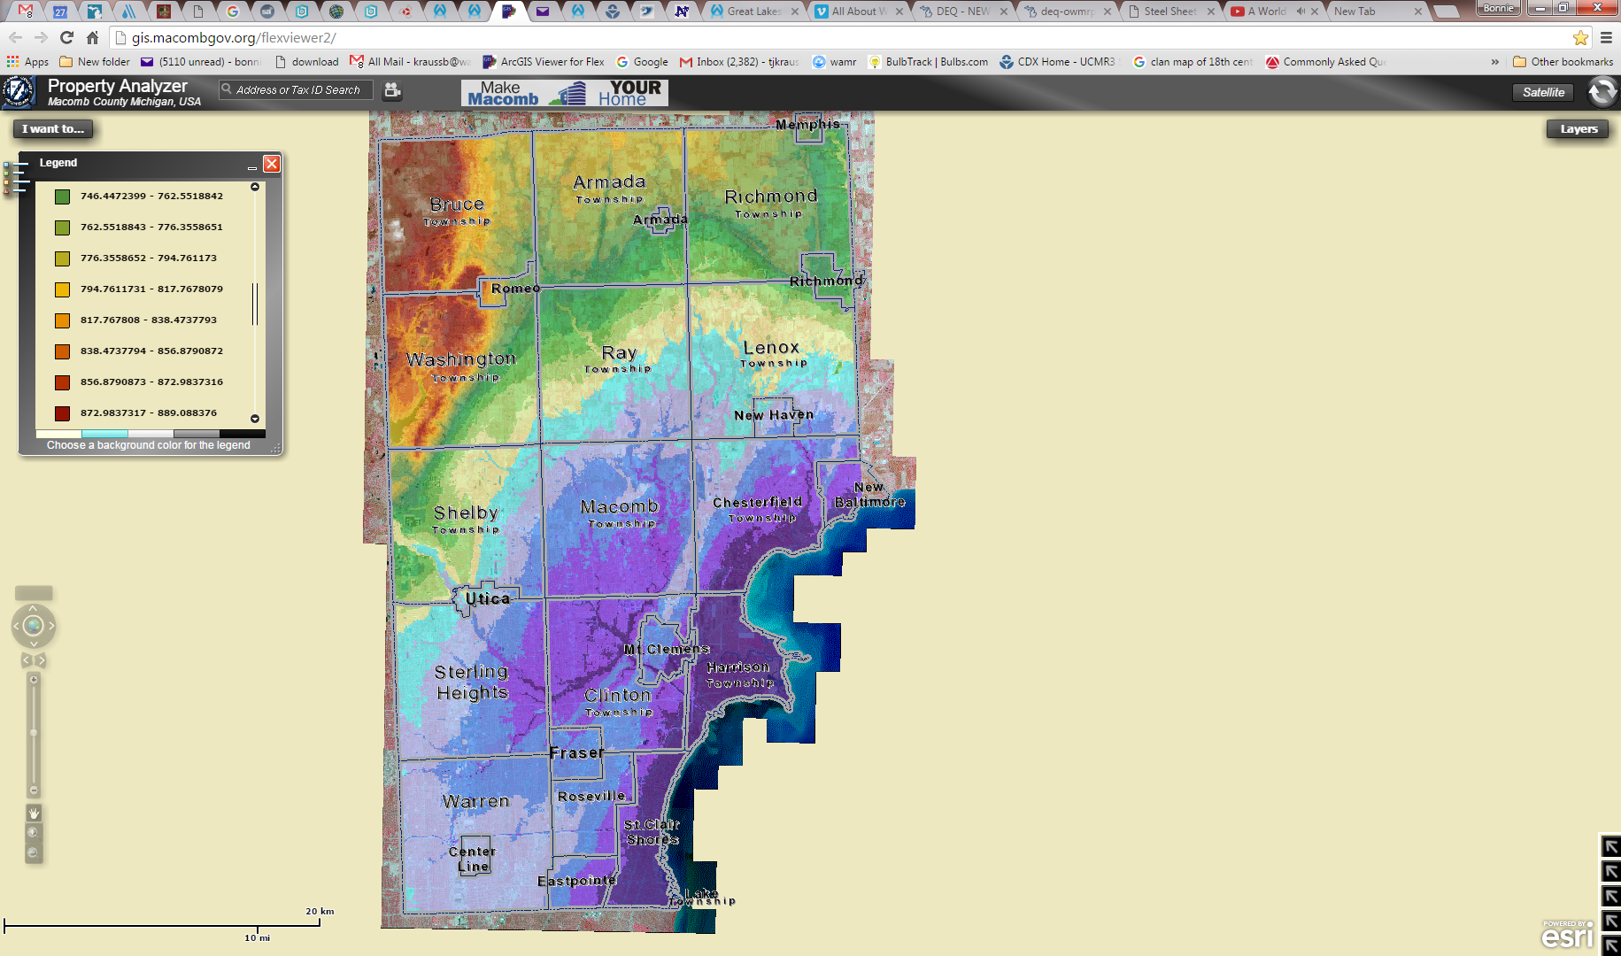
Elevation is Different Than Neighbors
There is a roughly 220 foot drop from the center of Washington to the 26 Mile Road border with Shelby.
Shelby gets even lower from there.
Macomb Township Hall is an 80 foot drop from Washington Township Hall

Slide 13
Why Do Neighbors Have Lower Fixed Cost
Each town recovers the costs from customers differently.
In the end, if it costs $3mm to provide water to a town, they need to recover that whether through fixed or variable.
Some, like Shelby, put most of their bill into variable.
Washington has a mix with greater emphasis on fixed, much like Detroit.

Slide 14
So We’re Screwed?
The Great Lakes Water Authority has only been in place for a short time.
They will give suburbs more influence over rates and operations.
They should improve the cost at which funds are borrowed to make infrastructure improvements.
In the meantime….

Slide 15
What We Can Do…
We must finish the effort to alter rates based on the water storage facility.
We will make an effort to pass through some of those savings in your rates prior to payout of the facility.
Each of us has to make personal choices on how much to spend on discretionary water usage.

Slide 16
How to Save
Leaks (silent) – water meter check and 15 minute dye check
Low flow toilets (7 gpf vs 2 gpf)
New shower head (post 1992 cut usage in half)
https://www.youtube.com/watch?v=8ZLZyy68Omk

